Slide 1
MAJOR PROJECT PRESENTATION FOR DEGREE OF B.TECH ON:
Crops Digital Solutions
UNDER THE GUIDANCE OF –
Prof. Chittaranjan Pradhan
Project and Presentation completed by :
Manik Gupta (1805311)
Siddhi Vinayak Tripathi (1805219)

Slide 2
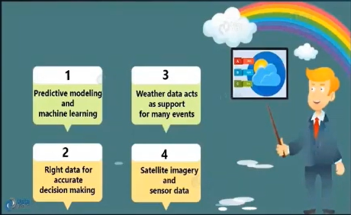
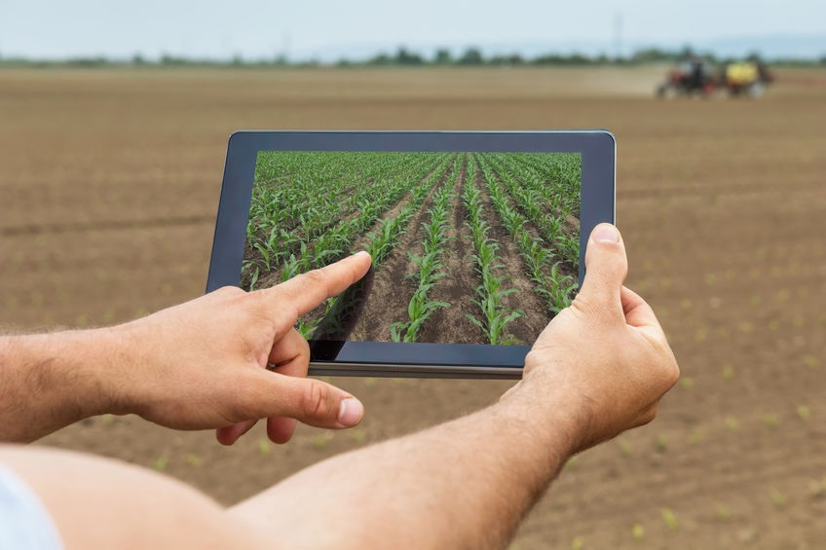
Objective:
The main aim of the project is to help the farmers in many ways with help of this model. Our model helps in prediction of crop, fertilizer and health of the crop.
All the data will be fed to our model then our system will suggest farmer or agriculturalist which crop is best for growing, what are nutrients missing in your field and damage severity of crop.
Digital Farming Solution , we propose crop prediction , fertilizer prediction and health prediction using Machine learning and Internet of things. The machine will recommends crop, fertilizer and health of crop for given parameter and soil.

Slide 3
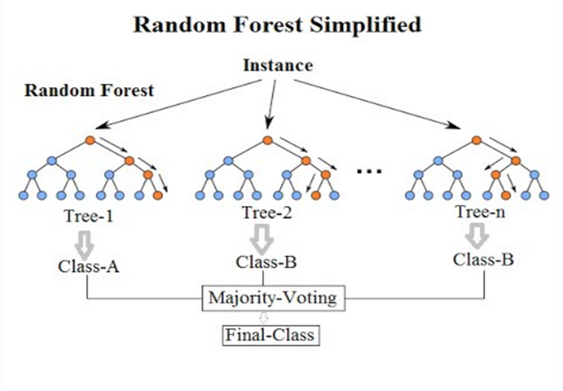
Random Forest:
It is based on the concept of bagging also known as bootstrap aggregation. It is a variance reduction ensemble method.

Slide 4
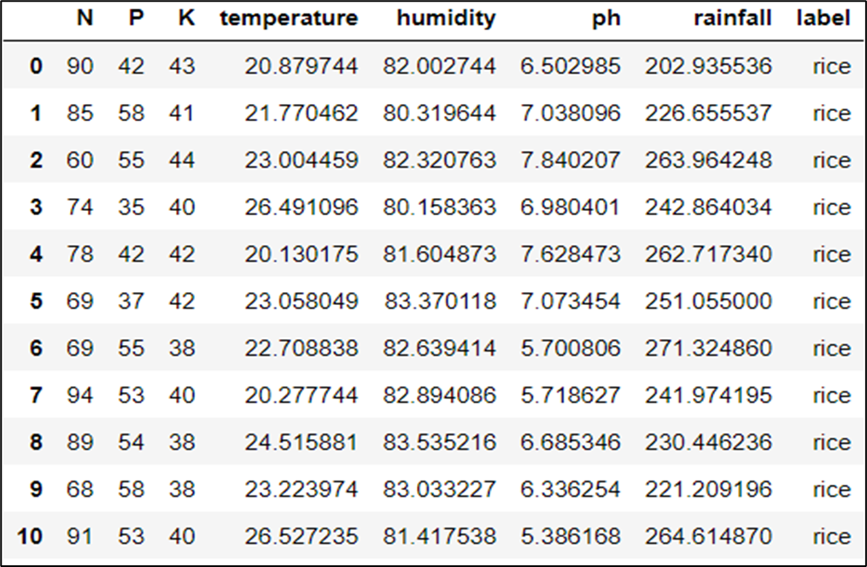
Model Implementation:
Model Building: Crop Prediction
This is the first dataset of the model for prediction of crop in fields. Here before building the model, a lot of feature engineering were done to understand the data.
One Hot encoding were applied on the label column and removed the dummy variable.
Data Analysis and extensive Feature Engineering were done.

Slide 5
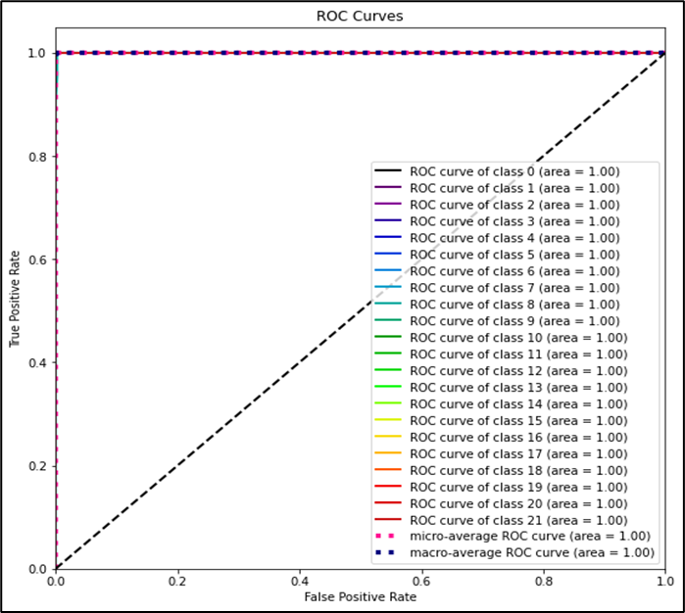
Model Implementation:
Model Building: Crop Prediction
The ROC curve of the dataset clear show that our model perfect for the prediction for the values.
Value of 1 for every class shows the prefect prediction for the unseen data.

Slide 6
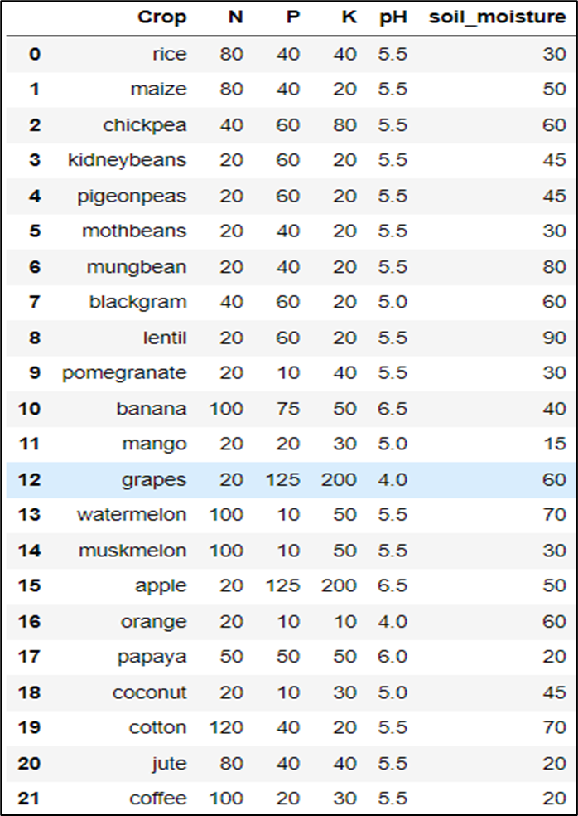
Model Implementation:
Model Building: Fertilizer Prediction
In the second model, we are not applying any ML model for that. We are only comparing the values of actual vs input.
We check the adequate values of Nutrients and pH and soil moisture of the given crop, and then we see for the differences between the given value of Nutrients and soil conditions and input values.

Slide 7
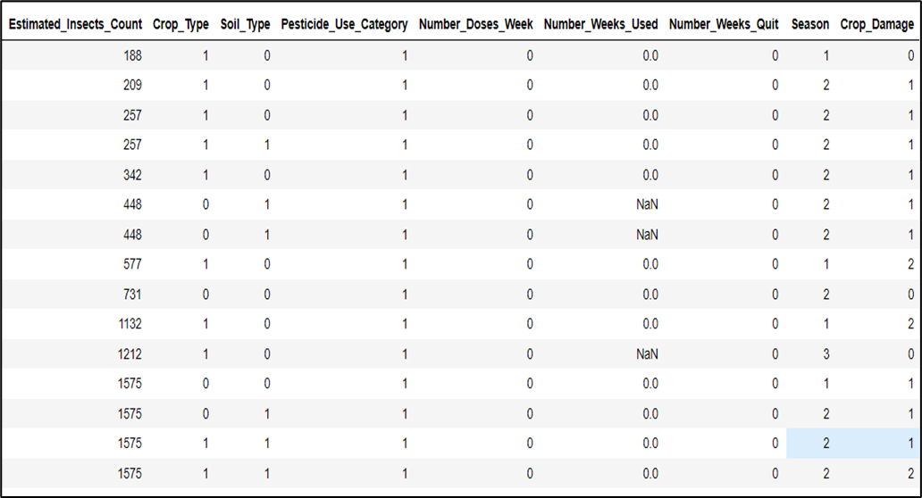
Model Implementation:
Model Building: Health Prediction
This is the dataset for the health prediction of the crop. Based on above columns, it predicts whether crop damage is by fertilizer or other means. If no damage happen it says none.
Many null values consists in the dataset, for that pre-processing were done and some feature engineering also done on that data.

Slide 8
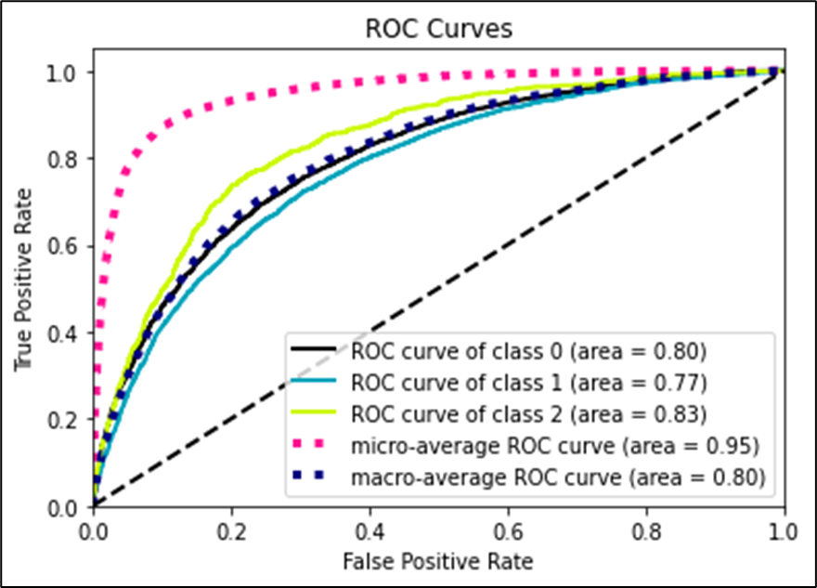
Model Implementation:
Model Building: Health Prediction
Random forest algorithm fitted well on our data with little to no overfitting. A lot of parameter tuning was done with the help of GridSearchCV library.
The model can be seen performing well. It seems to be doing a good job of fishing out the class-2 type data from the rest of them, which in this scenario is very important.

Slide 9
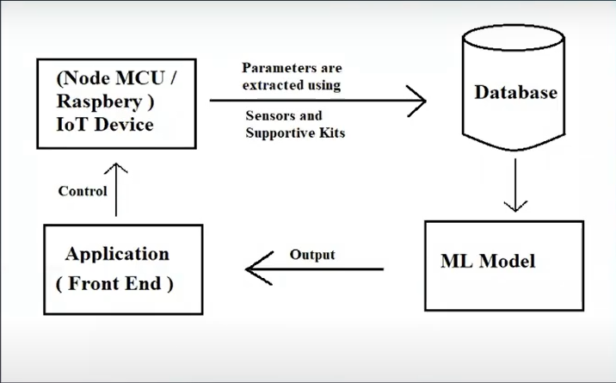
System Design:
This Model work with IoT for gathering of the environmental parameters using various sensors and then prediction are carried out with help of Machine learning
For Machine Learning Model, we have implemented the Random forest algorithm on gathered data. Then the trained model is deployed on the Heroku platform.
The output is collected and displayed on the website and it can be also used to input the parameter for model.

Slide 10
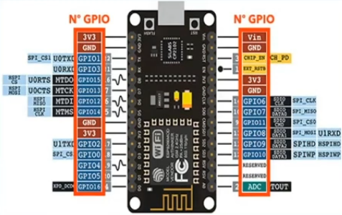
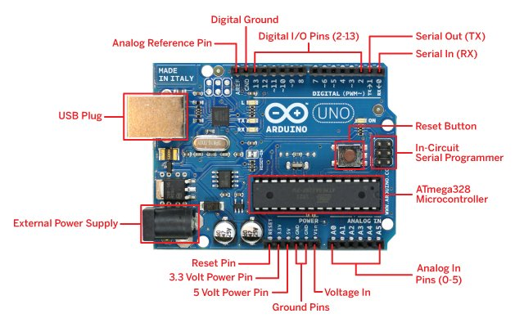
Model Implementation:
IoT Building:
NodeMCU and Arduino UNO R3 are used as microcontroller for sensor detection and data collection from agricultural field.
Various sensors are DHT11, Precipitation sensor, soil sensor etc. are been attached to the board for detection of the various eniviromental condition in farming fields.
Then collected data get fetched from the board and then model is applied on the data to get the particular result.

Slide 11
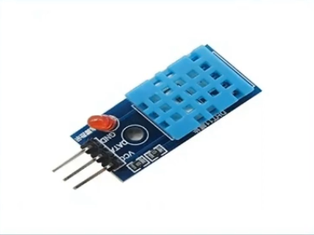
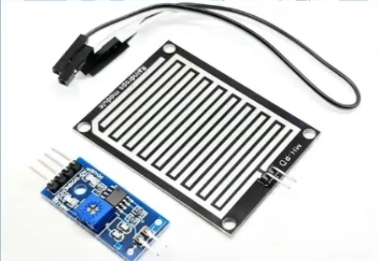
Model Implementation:
IoT Building (Sensor Used):
DHT11 is a temperature and humidty sensor , which is used to measure the enviroement temperature and humidity. It consist of humidity sensor and NTC thermistor for measurement. It converts analog signal from the both sensor and sends out a digital signal.
A Rain Sensor is composed of a rain detection plate with a comparator who manages intelligence. The sensor acts as a variable resistance that will change status: the resistance increases when the sensor is wet and the resistance is lower when the sensor is dry.

Slide 12
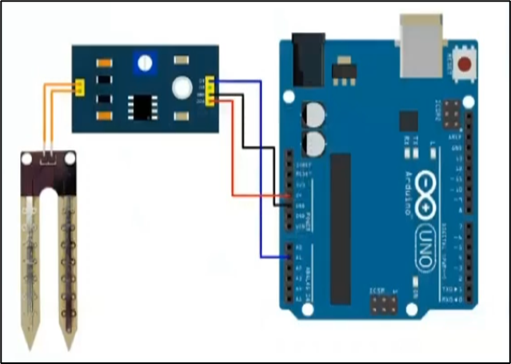
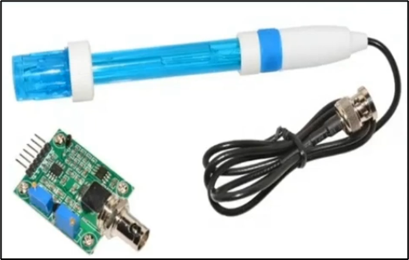
Model Implementation:
IoT Building (Sensor Used):
Soil Moisture Sensor measures the volumetric content of water inside the soil and gives us the moisture level as output. The sensor is equipped with both analog and digital output, so it can be used in both analog and digital modes.
The pH sensor, pH stands for potential Hydrogen, and it tells us whether a solution or substance is BASIC, ACIDIC, or NEUTRAL based on the pH Value, The Optimal pH range for most common hydroponic crops is between 5.5 and 6.0.

Slide 13
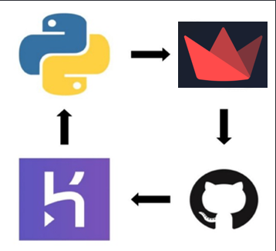
Deployment:
Application Deployment:
For the Deployment for machine learning model on heroku , a API will be created.
API stands for Application Programming Interface, it is used to access specific features or data of an application. There are mainly two files in the API. The first is the machine learning model that evaluates the numbers, and the second is the app which is the part of the API that receives inputs and returns outputs.
In the Deployment of the model , we convert our model into pickle file before using in the Streamlit Dashboard.

Slide 14
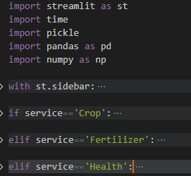
Deployment:
Application Deployment:

Slide 15
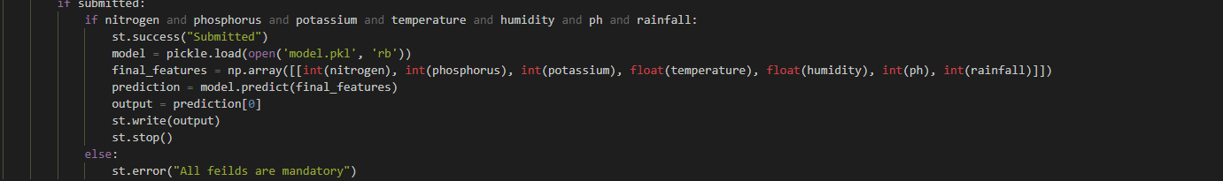
Deployment:
Application Deployment:
This is model api which is used for prediction in system. The model is used as pickle file in flask app for the prediction ,then from request method all the input fetch from form on website get deliver to flask app for the prediction.

Slide 16
Deployment:
Website Deployment:
Our Deployed website is structured into 5 different webpages, divided into 3 pages – Landing page , home page, ML model pages.
The above picture shows the landing page of our project. These pages follow the classic structure of having a navigation bar, content body and a footer. The web pages were also made responsive to accommodate various screen sizes.
The UI of these pages has been built using HTML, CSS and JavaScript. Many libraries of JavaScript were used to add animation in these pages.
Please visit and see https://digitalfarmingsolution.herokuapp.com/

Slide 17
Conclusion :
ML
IoT
Web Development

Slide 18
THANK YOU

